Slide 1
Supervised Learning Setup
Dept. of Computer Science
Faculty of Science and Technology
Lecturer No: |  | Week No: | 2 | Semester: | Fall 2023-24
Instructor: | Md Saef Ullah Miah (saef@aiub.edu)

Slide 2
Supervised Learning
Training experience: a set of labeled examples of the form
x = ( x₁, x₂, …, x_{n}, y )
where x_{j} are values for input variables and y is the output
This implies the existence of a “teacher” who knows the right answers
What to learn: A function f : X₁ × X₂ × … × X_{n} → Y , which maps the input variables into the output domain
Goal: minimize the error (loss function) on the training examples

Slide 3
Supervised Learning Problem
Given a data set D X₁ × X₂ × … × X_{n} × Y, find a function
h : X₁ × X₂ × … × X_{n} → Y
such that h(x) is a good predictor for the value of y
h is called a hypothesis
If Y is the real set, this problem is a regression
If Y is a finite discrete set, this problem is called classification
Binary classification if Y has 2 discrete value
Multiple classification if more than 2

Slide 4
Supervised Learning Steps
Decide what the training examples are
Data collection
Feature extraction or selection:
Discriminative features
Relevant and insensitive to noise
Input space X, output space Y, and feature vectors
Choose a model, i.e. representation for h;
or, the hypothesis class H = {h₁, …, h_{r}})
Choose an error function to define the best hypothesis
Choose a learning algorithm: regression or classification method
Training
Evaluation = testing

Slide 5
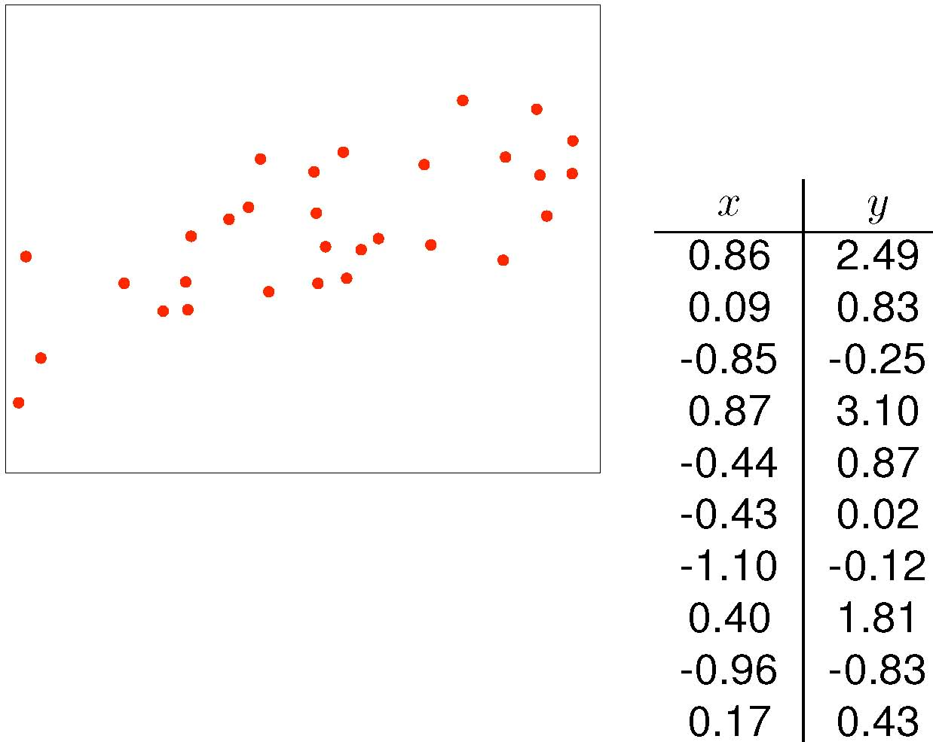
EX: What Model or Hypothesis Space H ?
Training examples:
e_{i} = <x_{i}, y_{i}>
for i = 1, …, 10

Slide 6
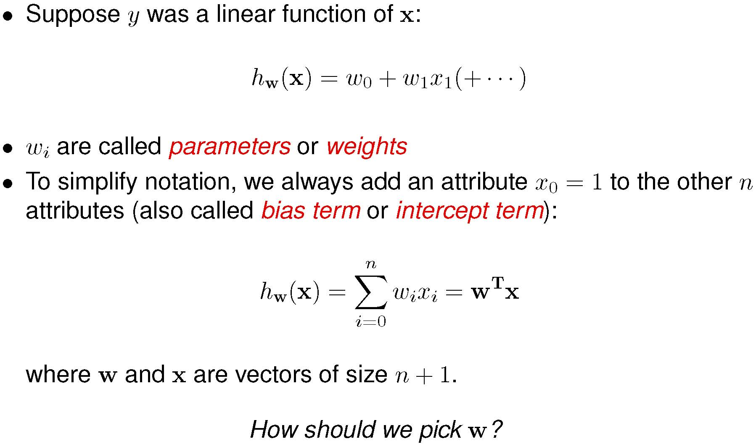
Linear Hypothesis

Slide 7
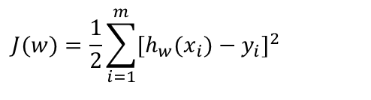
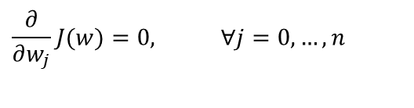
What Error Function ? Algorithm ?
Want to find the weight vector w = (w₀, …, w_{n}) such that h_{w}(x_{i}) ≈ y_{i}
Should define the error function to measure the difference between the predictions and the true answers
Thus pick w such that the error is minimized
Sum-of-squares error function (MSE):
Compute w such that J(w) is minimal, that is such that:
Learning Algorithm which find w: Least Mean Squares methods
$$J(w)=\frac{1}{2}\sum_{i=1}^{m}{[h_{w}(x_{i})−y_{i}]^{2}}$$
$$\frac{∂}{∂w_{j}}J(w)=0, ∀j=0,…,n$$
Notes:
1. Intuitively, w should make the predictions of h_{w} close to the true values y on the data we have

Slide 8
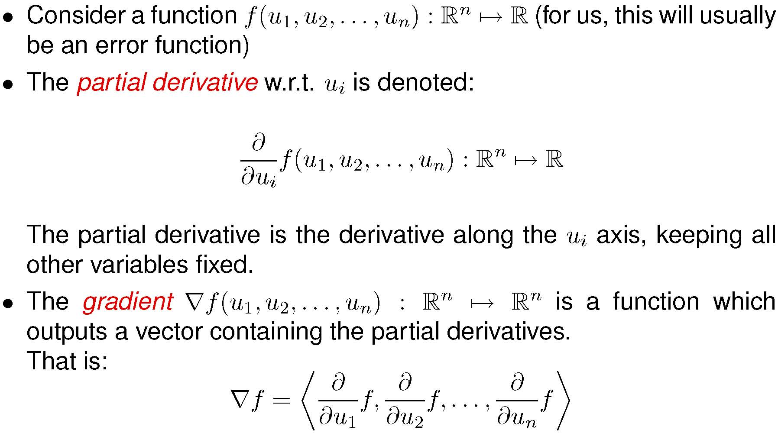
Some Linear Algebra

Slide 9
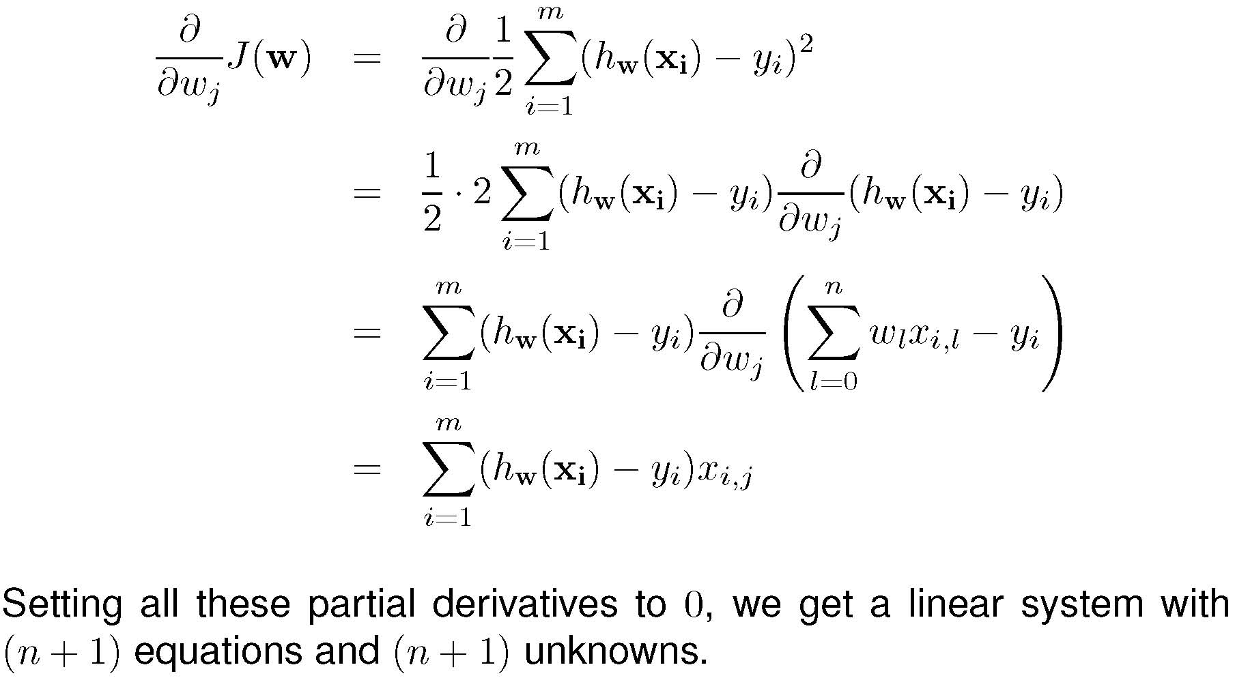
Some Linear Algebra …
Notes:
Derivative of the sum, with respect to w_{j}, is x_{ij}, and 0 otherwise.
▼J(w) = ( … ) = (0, …, 0) to obtain the solution for vector w

Slide 10
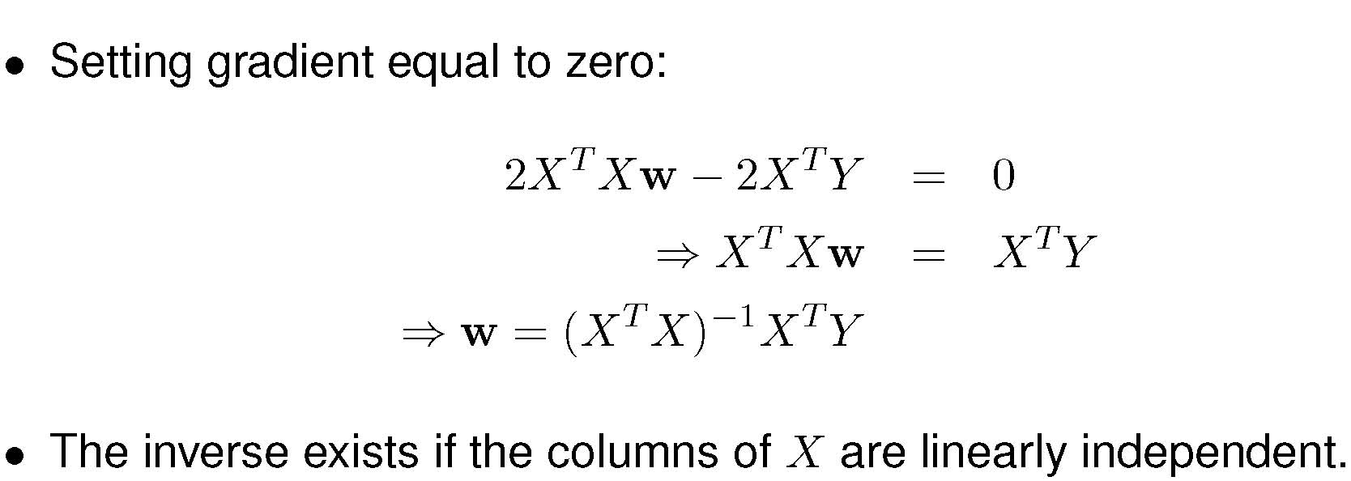
Some Linear Algebra - The Solution!
Notes:
1. The process in the previous slide can be performed as a matrix operation at once.

Slide 11
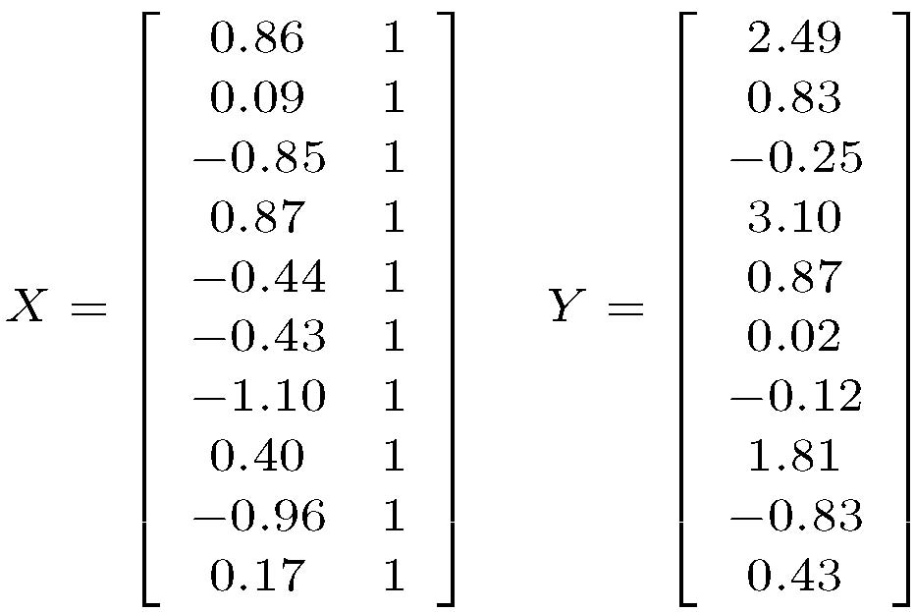
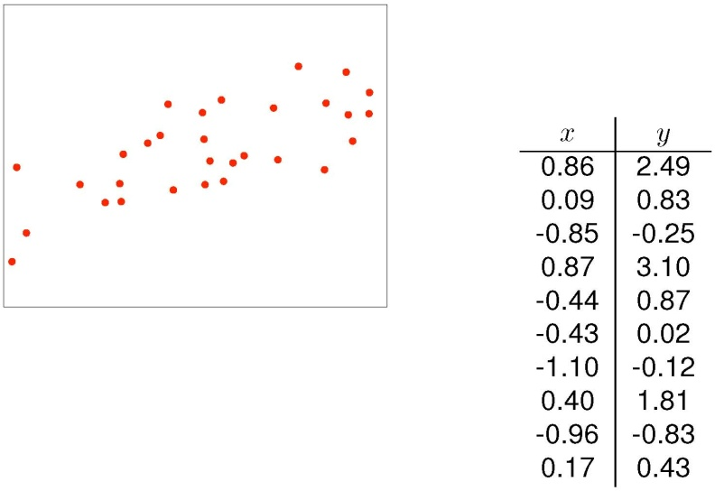
Example of Linear Regression - Data Matrices
Notes:
1. The process in the previous slide can be performed as a matrix operation at once.

Slide 12
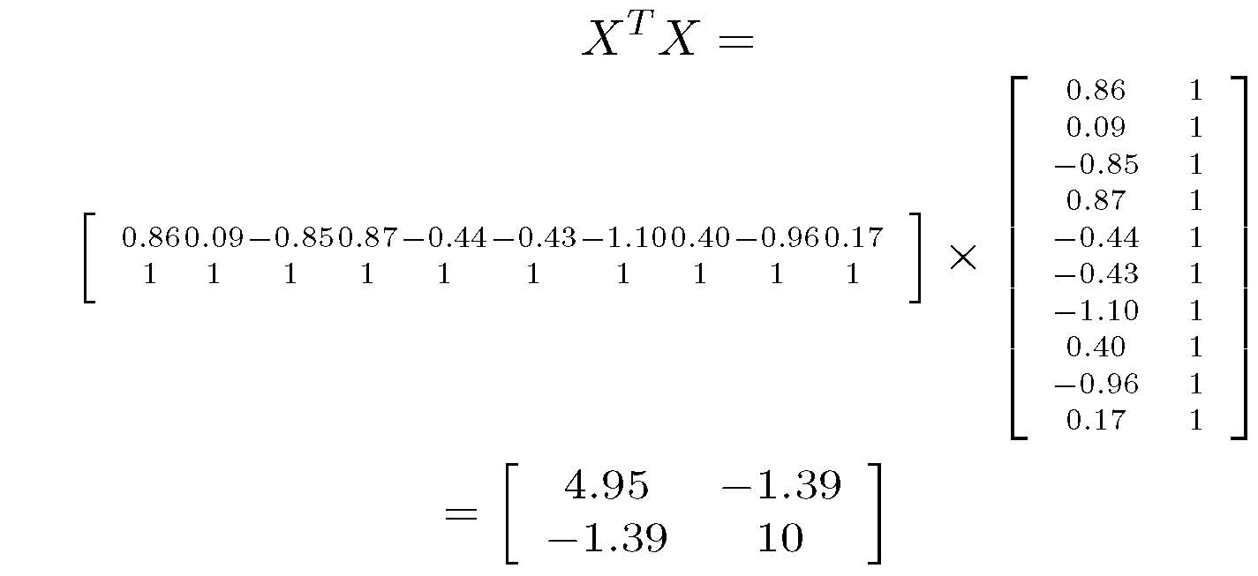
X^{T}X
Notes:
1. The process in the previous slide can be performed as a matrix operation at once.

Slide 13
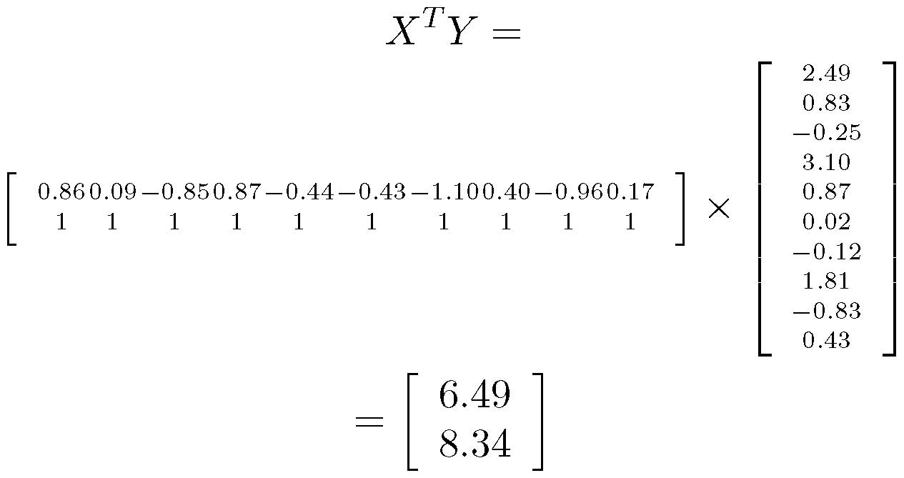
X^{T}Y
Notes:
1. The process in the previous slide can be performed as a matrix operation at once.

Slide 14
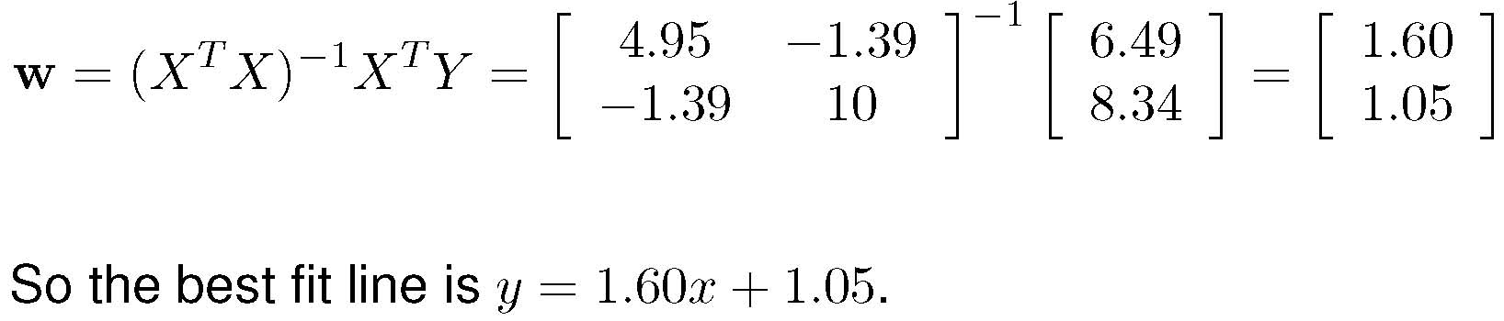
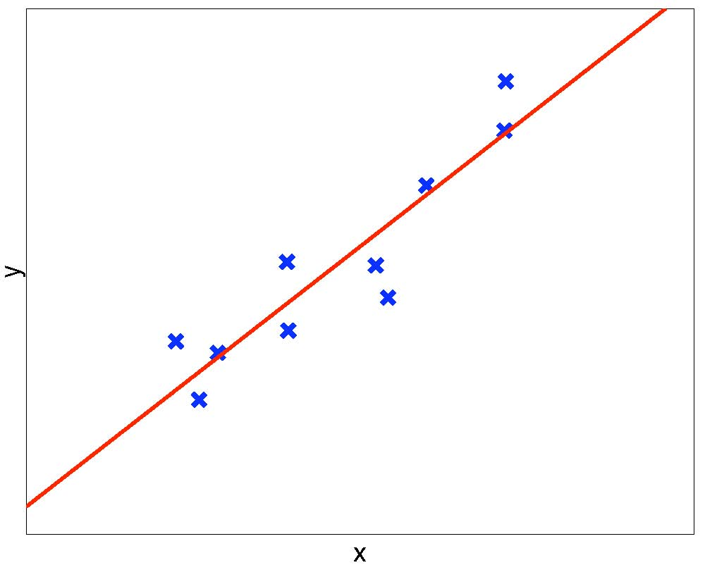
Solving for w – Regression Curve
Notes:
1. The process in the previous slide can be performed as a matrix operation at once.

Slide 15
Linear Regression - Summary
The optimal solution can be computed in polynomial time in the size of the data set.
Too simple for most real-valued problems
The solution is w = (X^{T}X)⁻¹X^{T}Y, where
X is the data matrix, augmented with a column of 1’s
Y is the column vector of target outputs
A very rare case in which an analytical exact solution is possible
Nice math, closed-form formula, unique global optimum
Problems when (X^{T}X) does not have an inverse
Possible solutions to this:
Include high-order terms in h_{w}
Transform the input X to some other space X’, and apply linear regression on X’
Use a different but more powerful hypothesis representation
Is Linear Regression enough ?

Slide 16
Generalization Ability vs Overfitting
Very important issue for any machine learning algorithms.
Can your algorithm predict the correct target y of any unseen x ?
Hypothesis may perfectly predict for all known x’s but not unseen x’s
This is called overfitting
Each hypothesis h has an unknown true error on the universe: J_{U}(h)
But we only measured the empirical error on the training set: J_{D}(h)
Let h₁ and h₂ be two hypotheses compared on training set D, such that we obtained the result J_{D}(h₁) < J_{D}(h₂)
If h₂ is “truly” better, that is J_{U}(h₂) < J_{U}(h₁)
Then your algorithm is overfitting, and won’t generalize to unseen data
We are not interested in memorizing the training set
In our examples, highest degree d hypotheses overfit (i.e. memorize) the data
We need methods to overcome overfitting.

Slide 17
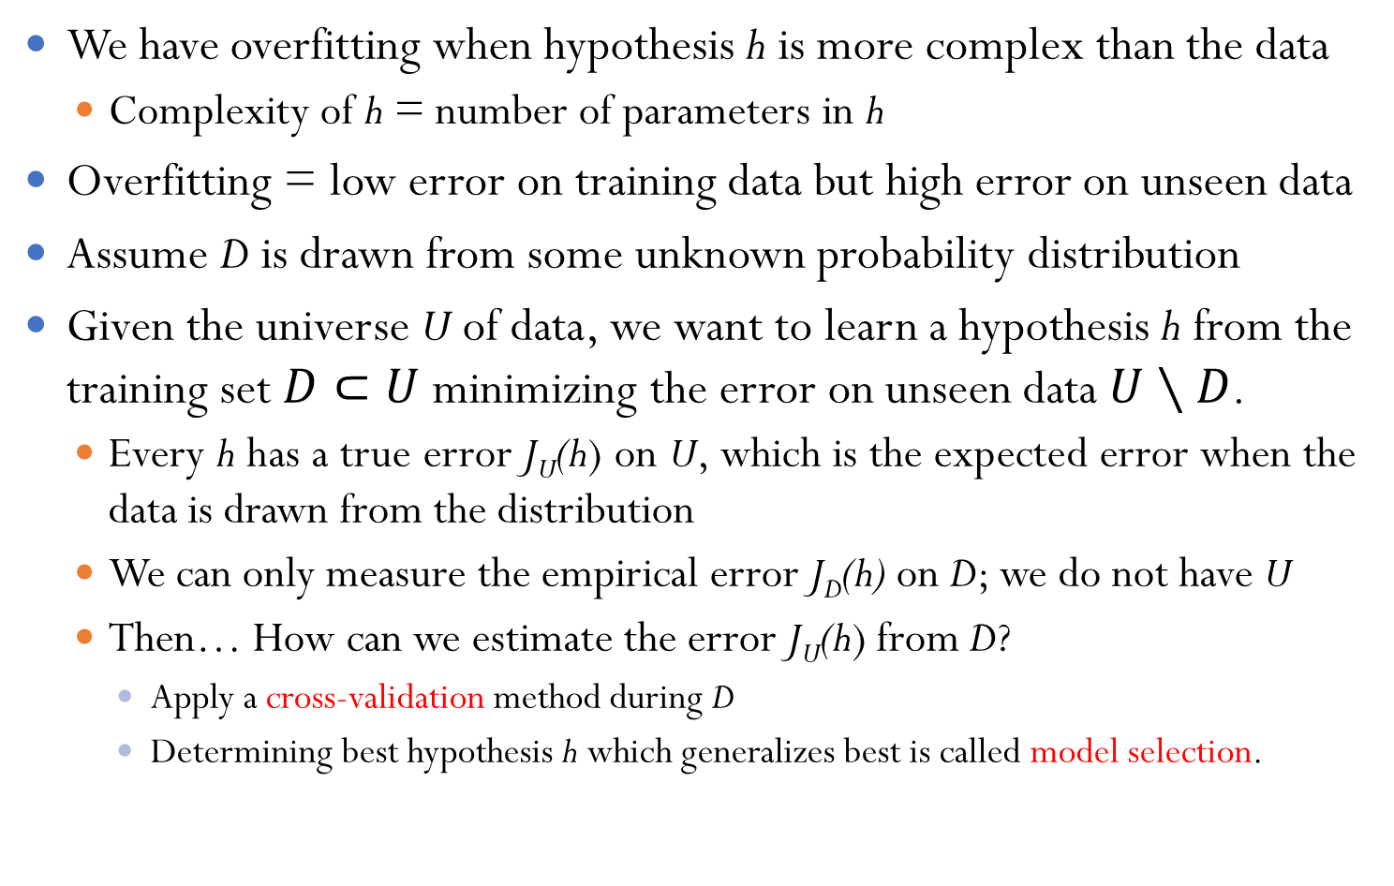
Overfitting
We have overfitting when hypothesis h is more complex than the data
Complexity of h = number of parameters in h
Overfitting = low error on training data but high error on unseen data
Assume D is drawn from some unknown probability distribution
Given the universe U of data, we want to learn a hypothesis h from the training set $D⊂U$ minimizing the error on unseen data $U∖D$.
Every h has a true error J_{U}(h) on U, which is the expected error when the data is drawn from the distribution
We can only measure the empirical error J_{D}(h) on D; we do not have U
Then… How can we estimate the error J_{U}(h) from D?
Apply a cross-validation method during D
Determining best hypothesis h which generalizes best is called model selection.

Slide 18
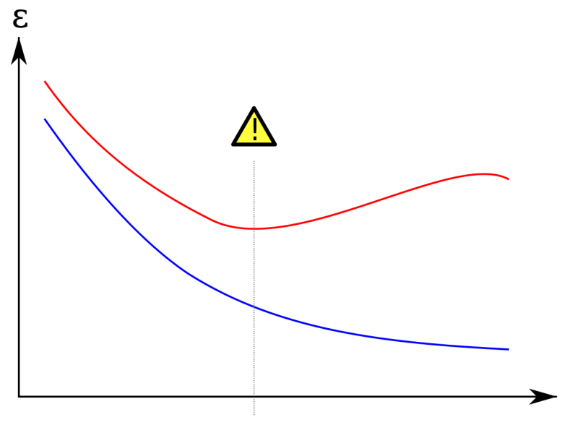
Avoiding Overfitting
Red curve = Test set
Blue curve = Training set
What is the best h?
Find the degree d
Such that J_{T}(h) minimal
Training error decreases with complexity of h; degree d in our example
Testing error decreases initially then increases
We need three disjoint sets of data T, V, U of D
Learn a potential h using the training set T
Estimate error of h using the validation set V
Report unbiased h using the test set U

Slide 19
Cross-Validation
General procedure for estimating the true error of a learner.
Methods of estimating expected prediction error
Helps selecting the best fit model
Helps ensuring model is not over fit
Types of CV: Holdout, k-fold, Stratified K-Fold, Leave one-out, Leave-P-Out/time series
Randomly partition the data into three subsets:
Training Set T: used only to find the parameters of classifier, e.g. w.
Validation Set V: used to find the correct hypothesis class, e.g. d.
Test Set U: used to estimate the true error of your algorithm
These three sets do not intersect, i.e. they are disjoint
Repeat cross-validation many times
Results are averaged to give true error estimate.

Slide 20
Cross-Validation and Model Selection
How to find the best degree d which fits the data D the best?
Randomly partition the available data D into three disjoint sets; training set T, validation set V, and test set U, then:
Cross-validation: For each degree d, perform a cross-validation method using T and V sets for evaluating the goodness of d.
Some cross-validation techniques to be discussed later
Model Selection: Given the best d found in step 1, find h_{w,d} using T and V sets and report the prediction error of h_{w,d} using the test set U
Some model selection approaches to be discussed later.
The prediction error on U is an unbiased estimate of the true error

Slide 21
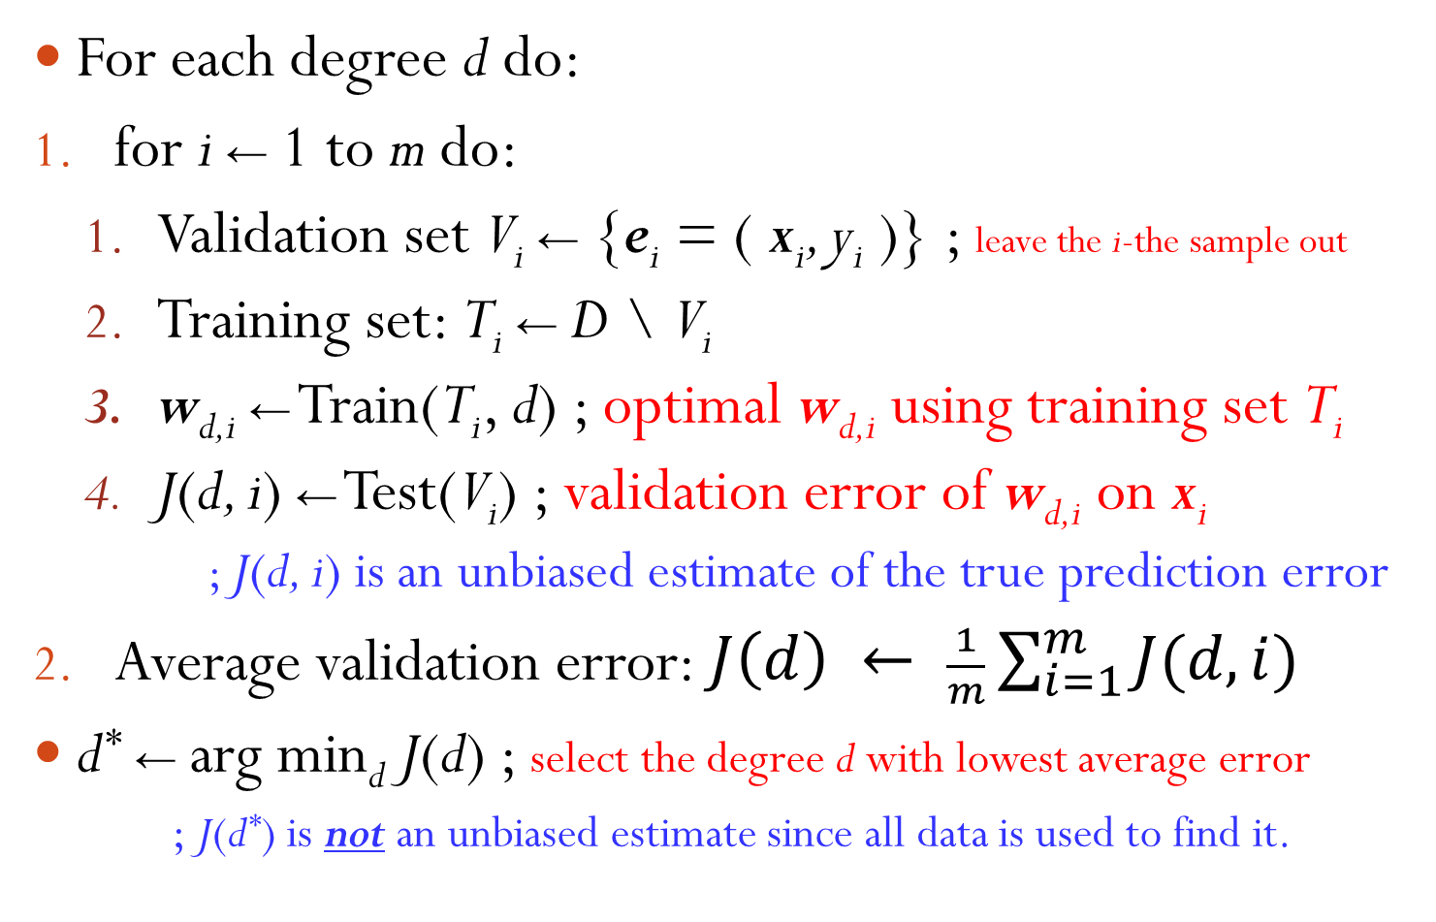
Leave-One-Out Cross-Validation
For each degree d do:
for i ← 1 to m do:
Validation set V_{i} ← {e_{i} = ( x_{i}, y_{i} )} ; leave the i-the sample out
Training set: T_{i} ← D \ V_{i}
w_{d,i} ← Train(T_{i}, d) ; optimal w_{d,i} using training set T_{i}
J(d, i) ← Test(V_{i}) ; validation error of w_{d,i} on x_{i}
; J(d, i) is an unbiased estimate of the true prediction error
Average validation error: $J\left(d\right) ← \frac{1}{m}\sum_{i=1}^{m}{J(d, i)}$
d* ← arg min_{d} J(d) ; select the degree d with lowest average error
; J(d*) is not an unbiased estimate since all data is used to find it.

Slide 22
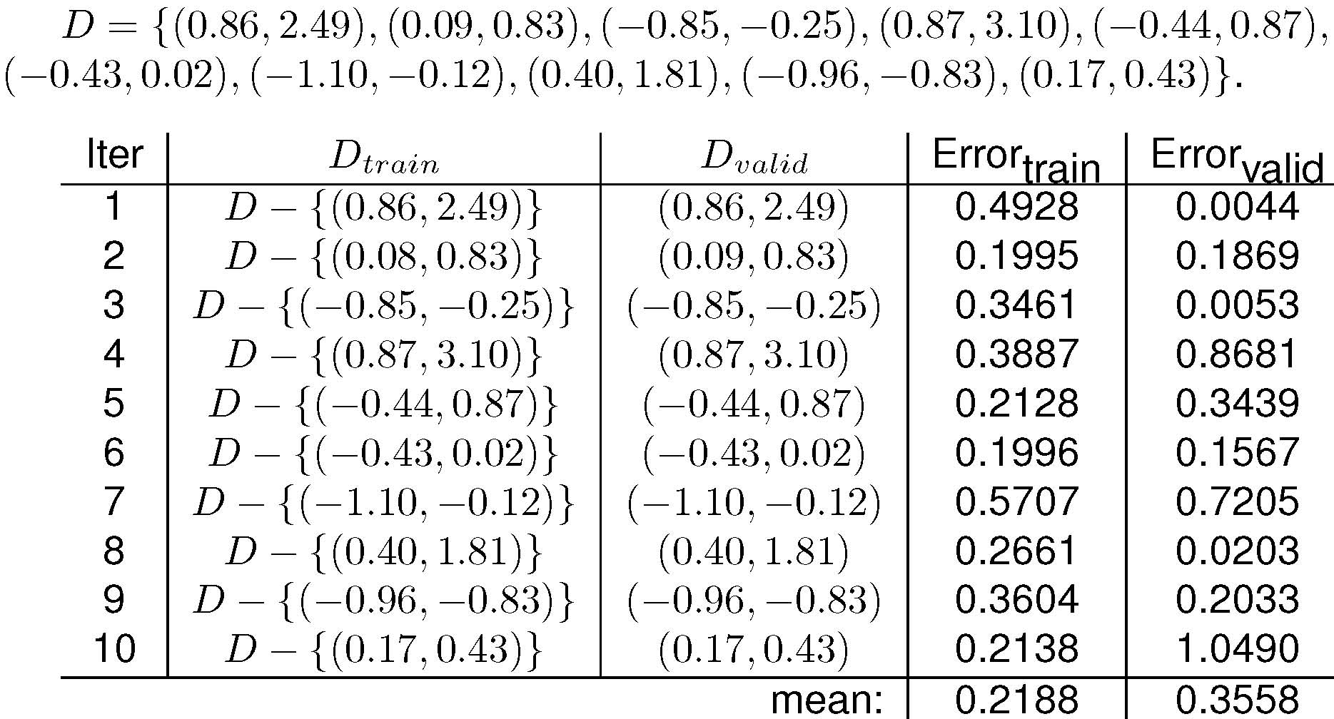
Example: Estimating True Error for d = 1

Slide 23
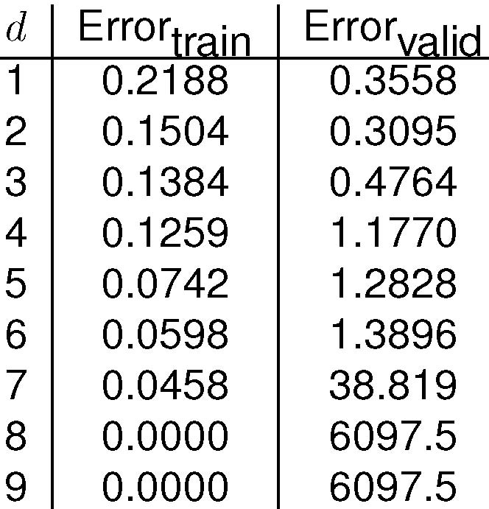
Example: Estimation results for all d
Optimal choice is d = 2
Overfitting for d > 2
Very high validation error for d = 8 and 9

Slide 24
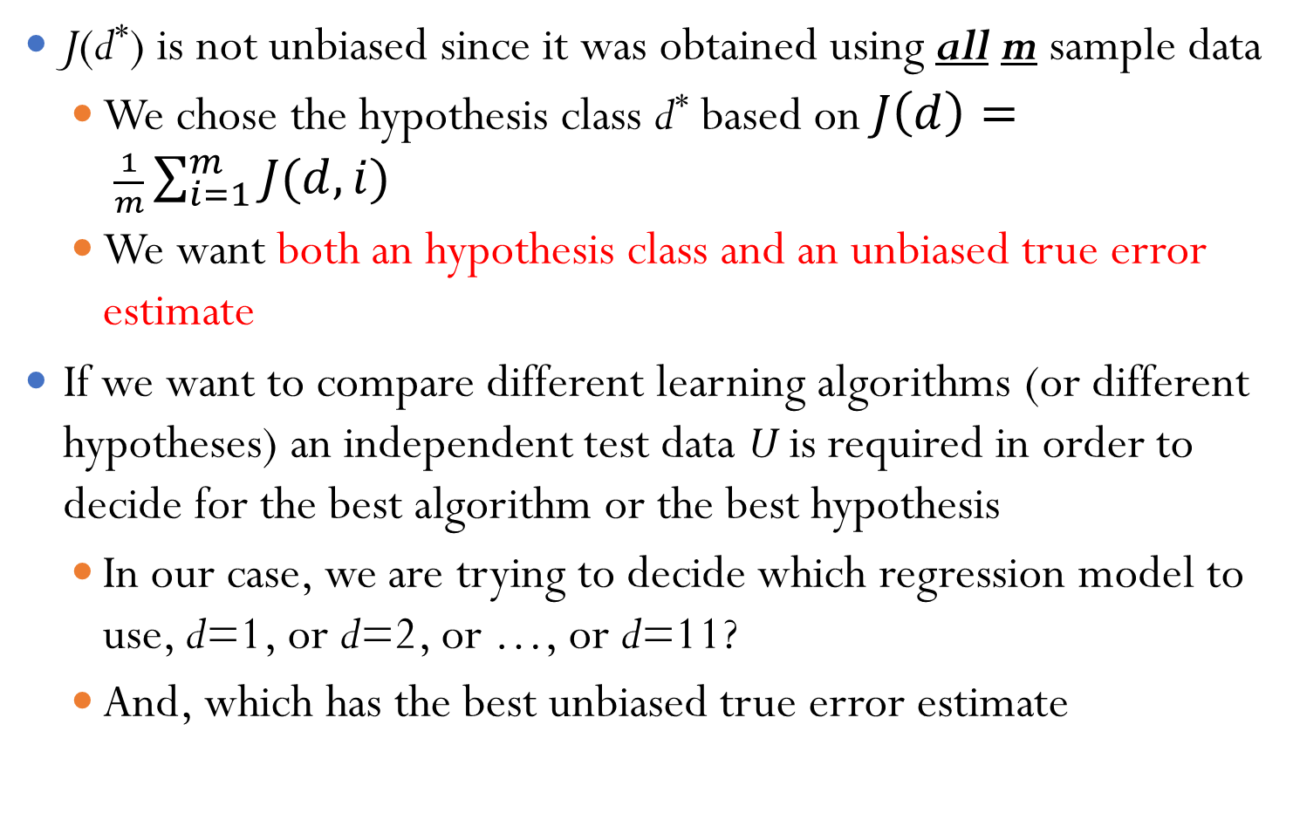
Model Selection
J(d*) is not unbiased since it was obtained using all m sample data
We chose the hypothesis class d* based on $J\left(d\right)= \frac{1}{m}\sum_{i=1}^{m}{J(d, i)}$
We want both an hypothesis class and an unbiased true error estimate
If we want to compare different learning algorithms (or different hypotheses) an independent test data U is required in order to decide for the best algorithm or the best hypothesis
In our case, we are trying to decide which regression model to use, d=1, or d=2, or …, or d=11?
And, which has the best unbiased true error estimate

Slide 25
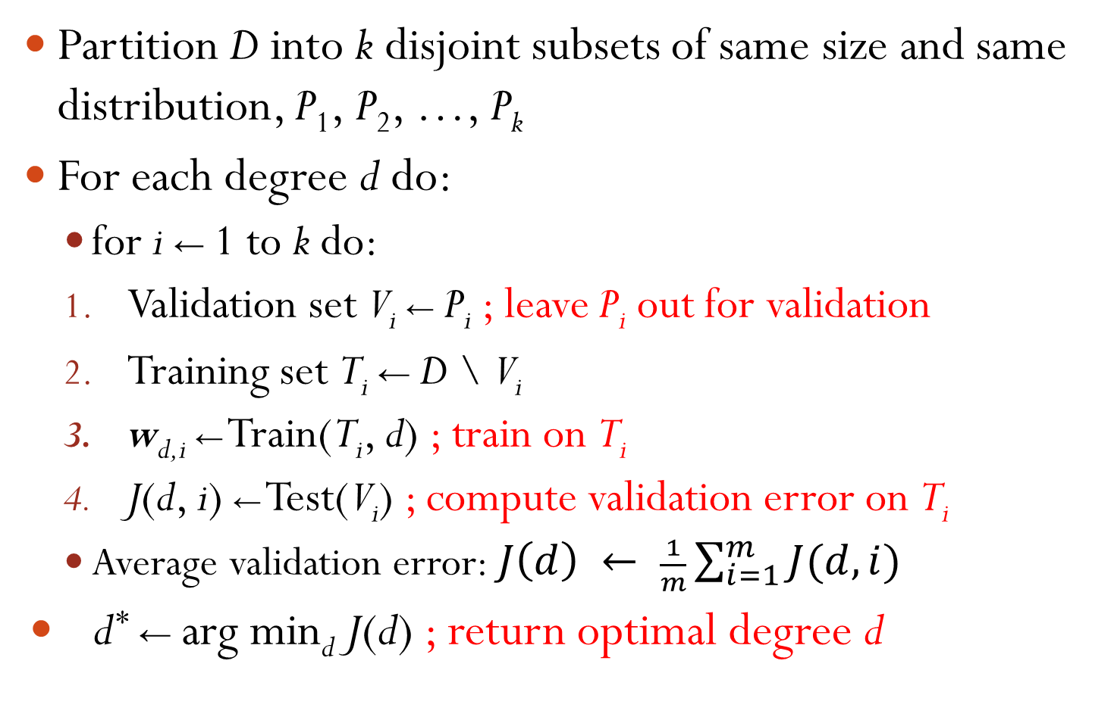
k-Fold Cross-Validation
Partition D into k disjoint subsets of same size and same distribution, P₁, P₂, …, P_{k}
For each degree d do:
for i ← 1 to k do:
Validation set V_{i} ← P_{i} ; leave P_{i} out for validation
Training set T_{i} ← D \ V_{i}
w_{d,i} ← Train(T_{i}, d) ; train on T_{i}
J(d, i) ← Test(V_{i}) ; compute validation error on T_{i}
Average validation error: $J\left(d\right) ← \frac{1}{m}\sum_{i=1}^{m}{J(d, i)}$
d* ← arg min_{d} J(d) ; return optimal degree d
Notes:
1. What if we have more features for each input x?

Slide 26
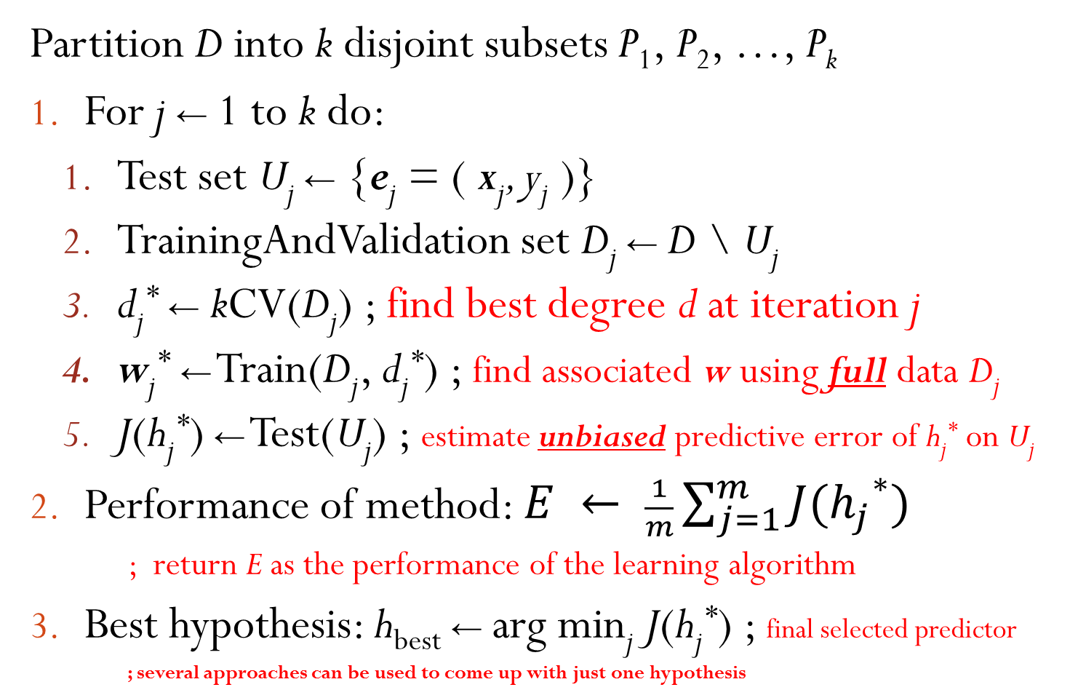
kCV-Based Model Selection
Partition D into k disjoint subsets P₁, P₂, …, P_{k}
For j ← 1 to k do:
Test set U_{j} ← {e_{j} = ( x_{j}, y_{j} )}
TrainingAndValidation set D_{j} ← D \ U_{j}
d_{j}* ← kCV(D_{j}) ; find best degree d at iteration j
w_{j}* ← Train(D_{j}, d_{j}*) ; find associated w using full data D_{j}
J(h_{j}*) ← Test(U_{j}) ; estimate unbiased predictive error of h_{j}* on U_{j}
Performance of method: $E ← \frac{1}{m}\sum_{j=1}^{m}{J({h_{j}}^{∗})}$
; return E as the performance of the learning algorithm
Best hypothesis: h_{best} ← arg min_{j} J(h_{j}*) ; final selected predictor
; several approaches can be used to come up with just one hypothesis

Slide 27
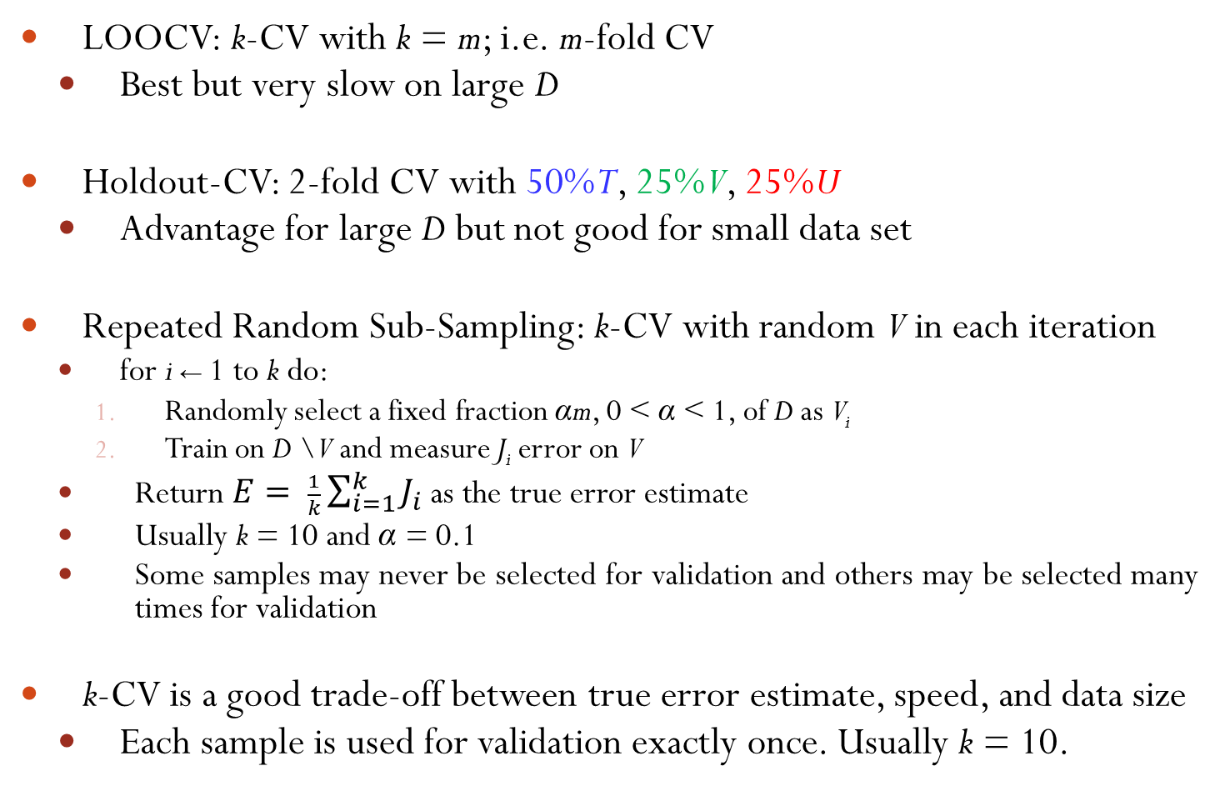
Variations of k-Fold Cross-Validation
LOOCV: k-CV with k = m; i.e. m-fold CV
Best but very slow on large D
Holdout-CV: 2-fold CV with 50%T, 25%V, 25%U
Advantage for large D but not good for small data set
Repeated Random Sub-Sampling: k-CV with random V in each iteration
for i ← 1 to k do:
Randomly select a fixed fraction αm, 0 < α < 1, of D as V_{i}
Train on D \ V and measure J_{i} error on V
Return $E= \frac{1}{k}\sum_{i=1}^{k}{J_{i}}$ as the true error estimate
Usually k = 10 and α = 0.1
Some samples may never be selected for validation and others may be selected many times for validation
k-CV is a good trade-off between true error estimate, speed, and data size
Each sample is used for validation exactly once. Usually k = 10.

Slide 28
Learning a Class from Examples
Class C of a “family car”
Prediction: Is car x a family car?
Knowledge extraction: What do people expect from a family car?
Output:
Positive (+) and negative (–) examples
Input representation:
x₁: price, x₂ : engine power

Slide 29
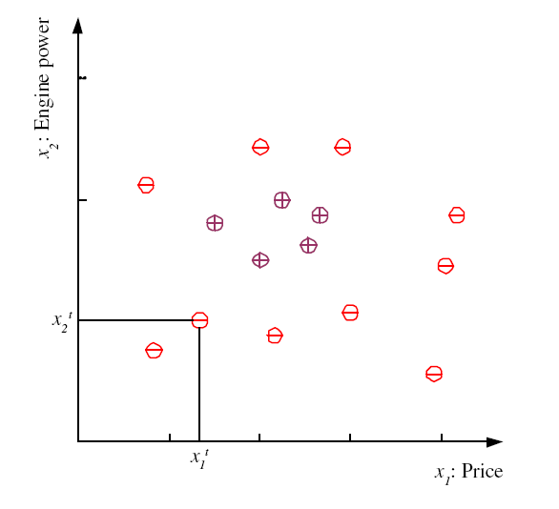
Training set X

Slide 30
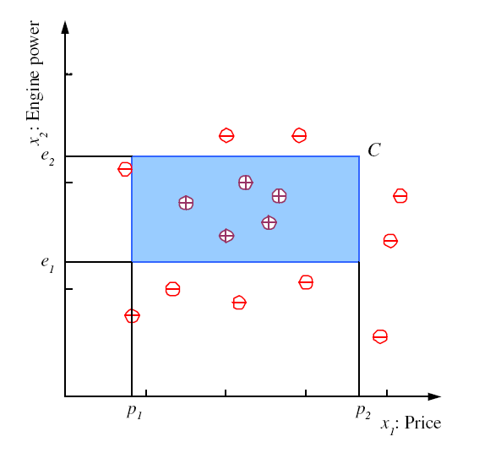
Class C

Slide 31
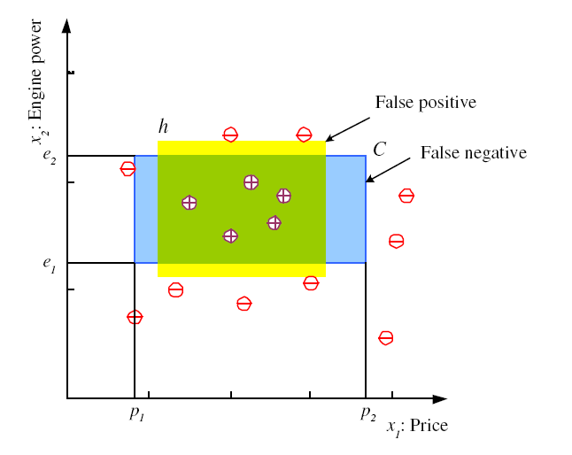
Hypothesis class H
Error of h on H

Slide 32
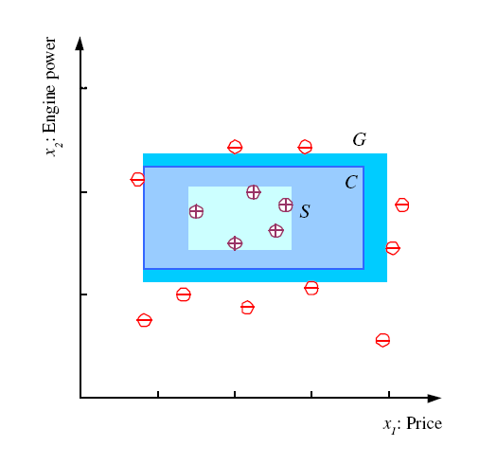
S, G, and the Version Space
most specific hypothesis, S
most general hypothesis, G
h ∈ H, between S and G is
consistent
and make up the
version space
(Mitchell, 1997)

Slide 33
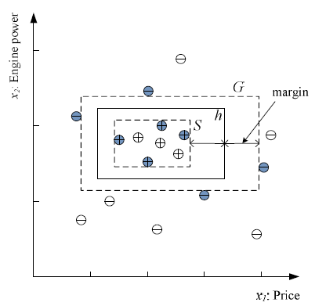
Margin
Choose h with largest margin

Slide 34
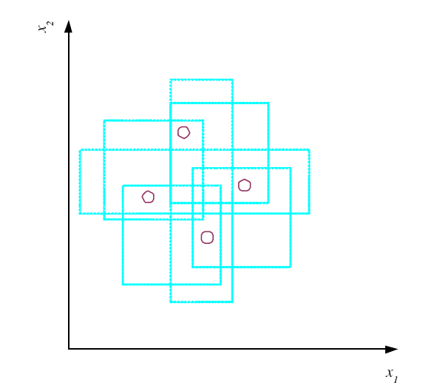
VC Dimension
N points can be labeled in 2^{N} ways as +/–
H shatters N if there
exists h ∈ H consistent
for any of these:
VC(H ) = N
An axis-aligned rectangle shatters 4 points only !

Slide 35
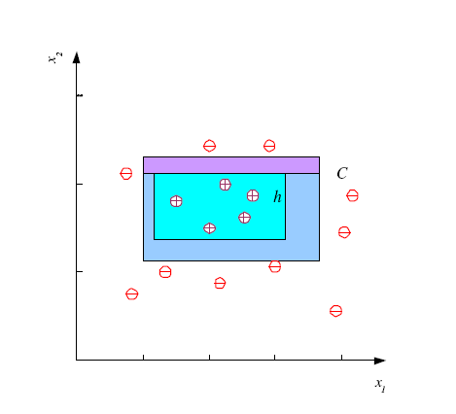
Probably Approximately Correct (PAC) Learning
How many training examples N should we have, such that with probability at least 1 ‒ δ, h has error at most ε ?
(Blumer et al., 1989)
Each strip is at most ε/4
Pr that we miss a strip 1‒ ε/4
Pr that N instances miss a strip (1 ‒ ε/4)^{N}
Pr that N instances miss 4 strips 4(1 ‒ ε/4)^{N}
4(1 ‒ ε/4)^{N} ≤ δ and (1 ‒ x)≤exp( ‒ x)
4exp(‒ εN/4) ≤ δ and N ≥ (4/ε)log(4/δ)

Slide 36
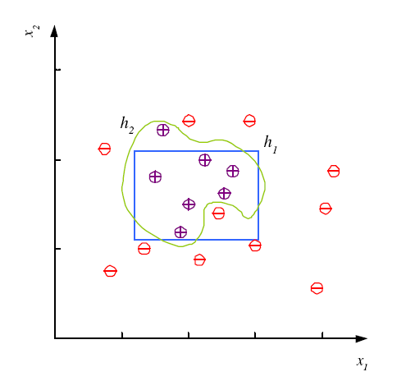
Noise and Model Complexity
Use the simpler one because
Simpler to use
(lower computational
complexity)
Easier to train (lower
space complexity)
Easier to explain
(more interpretable)
Generalizes better (lower
variance - Occam’s razor)

Slide 37
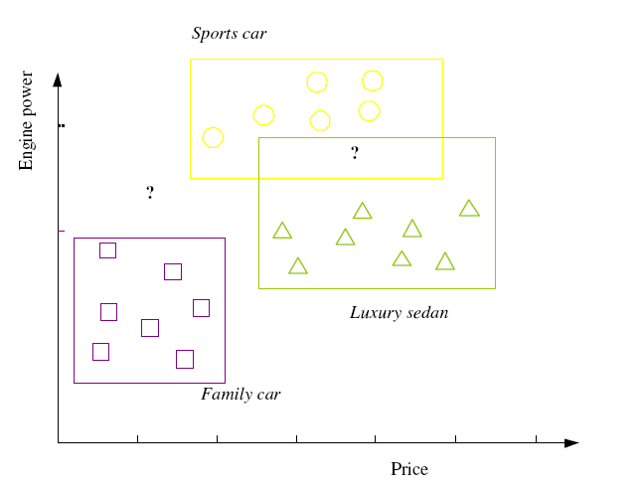

Multiple Classes, C_{i} i=1,...,K
Train hypotheses
h_{i}(x), i =1,...,K:

Slide 38
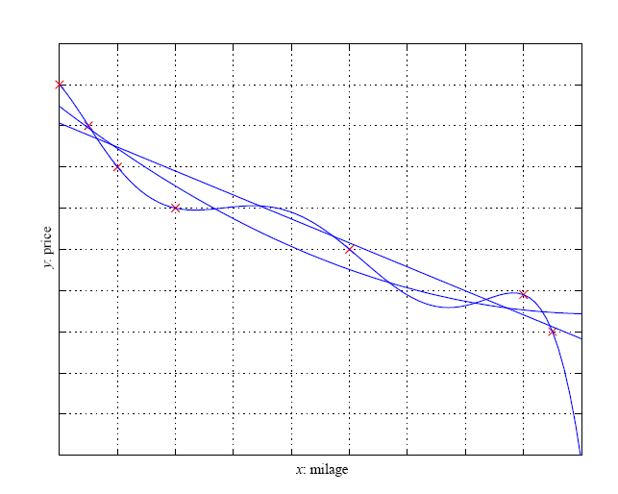
Regression

Slide 39
Model Selection & Generalization
Learning is an ill-posed problem; data is not sufficient to find a unique solution
The need for inductive bias, assumptions about H
Generalization: How well a model performs on new data
Overfitting: H more complex than C or f
Underfitting: H less complex than C or f

Slide 40
Triple Trade-Off
There is a trade-off between three factors (Dietterich, 2003):
Complexity of H, c (H),
Training set size, N,
Generalization error, E, on new data
As N, E↓
As c (H), first E↓ and then E

Slide 41
Cross-Validation
To estimate generalization error, we need data unseen during training. We split the data as
Training set (50%)
Validation set (25%)
Test (publication) set (25%)
Resampling when there is few data

Slide 42
Dimensions of a Supervised Learner
Model:
Loss function:
Optimization procedure:

Slide 43
Textbook/ Reference Materials
Introduction to Machine Learning by Ethem Alpaydin
Machine Learning: An Algorithmic Perspective by Stephen Marsland
Pattern Recognition and Machine Learning by Christopher M. Bishop

